Slide 1
URBN Data Science
Automated fashion product attribution: A case study in using custom vision services vs. manually developed machine learning models
Tom Szumowski, Data Scientist Alan Rosenwinkel, Ph.D., Sr. Data Scientist Robin Sanders, Data Science Intern
September 20th, 2018

Slide 2
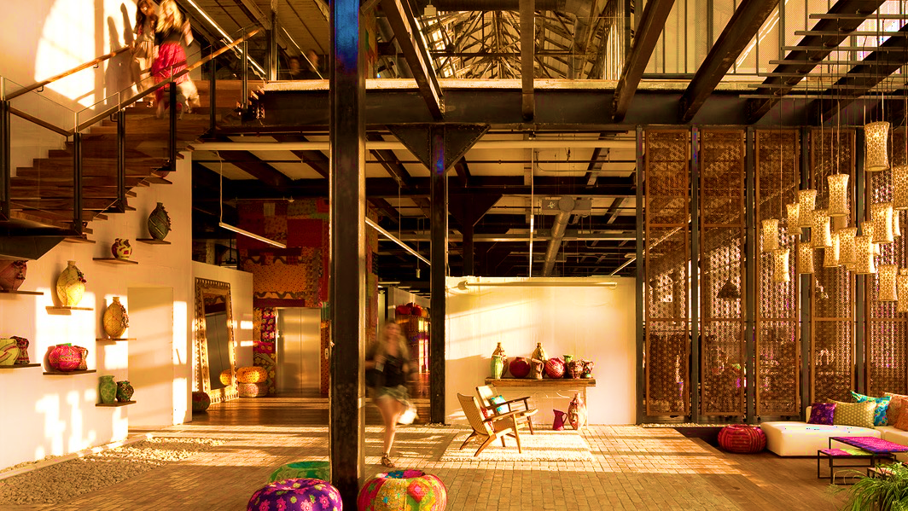
About URBN
Urban Outfitters, Inc (URBN)
Urban Outfitters, Anthropologie, Free People, BHLDN, Terrain and the Vetri Family
URBN Data Science
Machine Learning: Leverage ML to drive business value
Consultation: Vendor evaluations, predictive analytics
Automation: Enhance insight, enable data-driven decisions
Industry Trends
Omni-channel
Personalization
Notes:
Model unpublished
URBN
Wide age range of customers: Many Anthro customers who started when we opened still here
Different brands have different customers
URBN and Anthro are more “life stage” brands, FP niche
Competitors: fast fashion to department stores
URBN Data Science
Two roles: consultation and ML practitioners
Industry Trends
More purchase coming from ecomm but return rate is higher there
Oppurtunity for omni-channel: pick pack and ship, buy online pick-up in store
Opportunities:
Automate manual processes: e.g. reporting
Enable data-driven decisions: e.g. Celect in-store assortment planning, CLV
Improve products and customer experience: e.g. Personalization, visual search, recommendations, etc.
People:
Data science group: started 1 year ago. Still in exploratory phase to identify longer-term opportunities
Data engineering group: robust engineering organization with data engineering to deploy AI. Don’t need to rely on consultants or 3-rd party integrators
TODO:
Incorporate quick point on why attributes for us

Slide 3



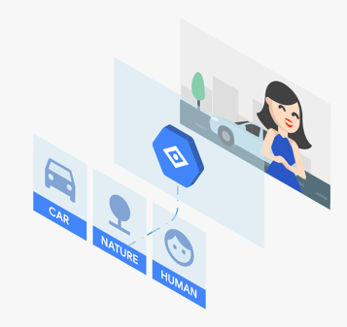
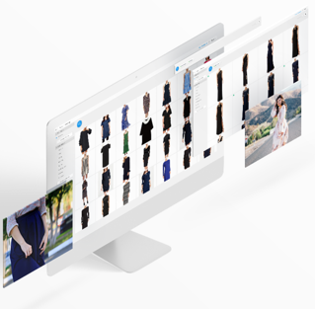
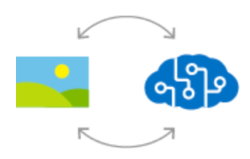
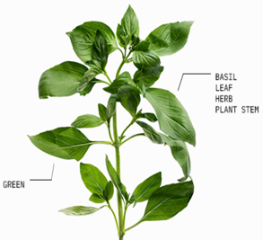
Custom Vision Services
Google Cloud AutoML Vision ^{BETA}
Clarifai
Salesforce Einstein Vision
Microsoft Azure Custom Vision^{PREVIEW}
IBM Watson Visual Recognition
Notes:
Talking Points
Clarify differences between custom vision services and general vision services
Motivation of services is to “democratize AI”, or to make these technologies more accessible to a larger audience, including developers and analysts
Note relationships:
Pre-alpha tester with Google AutoML for several months
Trial tester with Clarifai
Trials provided by Salesforce
IBM Watson priced out
Two orders of magnitude more expensive
What costs max $50 to train on all other costs $5000 on IBM Watson
URBN Data Science Objectives:
ML practitioners at the core
However, looking for another tool in our belt to streamline the ML workflow
Performance important, but so is price, usability, deployment, etc.
References
Analysis of ML services from cloud providers. Medium.com: https://medium.com/kontikilabs/comparing-machine-learning-ml-services-from-various-cloud-ml-service-providers-63c8a2626cb6

Slide 4
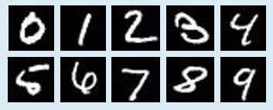
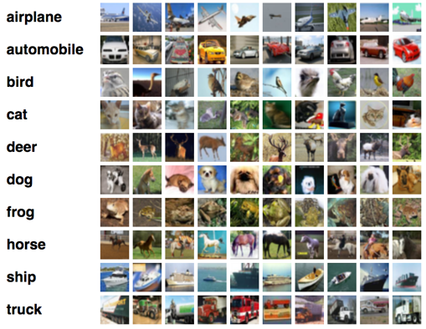
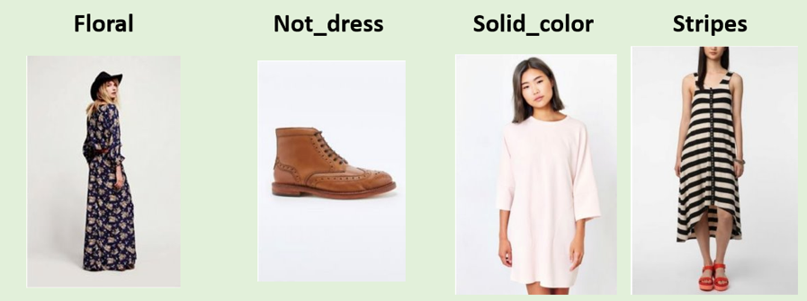
Experiment Datasets (A) Full datasets (shown) (B) Min allowed (100 training samples / class)
MNIST
(60K train, 10K test)
Fashion MNIST
(60K train, 10K test)
CIFAR-10 (50K train, 10K test)
UO Small Dress Dataset (~5K train, ~500 test)
Notes:
Talking Points
Dataset Diversity: Objective was to try public benchmarks as a common basis of comparison to leaderboards, as well as try a local more business relevant dataset
Small Dataset Sizes: Claim of Custom Vision Services is they can apply transfer learning on small number of labels. So we wish to test that
(In addition, these services cost money, unsure if we’ll mention that)
Dress Dataset:
Dress prints.
Kept to simple classes for interpretability.
Left one obvious class (shoes) with some challenges mixed in.
Derived through some human labeling and some from internal DBs
Minor class imbalance (max 6:1)
References:
- MLAXiao, Han, Kashif Rasul, and Roland Vollgraf. "Fashion-mnist: a novel image dataset for benchmarking machine learning algorithms." arXiv preprint arXiv:1708.07747 (2017).
LeCun, Yann, Corinna Cortes, and C. J. Burges. "MNIST handwritten digit database." AT&T Labs [Online]. Available: http://yann. lecun. com/exdb/mnist 2 (2010).
- Krizhevsky, Alex, Vinod Nair, and Geoffrey Hinton. "The CIFAR-10 dataset." online: http://www. cs. toronto. edu/kriz/cifar. html (2014).
APA

Slide 5
Performance Comparison Classification Accuracy ¹
AUC | MNIST |  | Fashion MNIST |  | CIFAR-10 |  | UO Dresses
 | Min² | Full | Min² | Full | Min² | Full | Min² | Full
Google AutoML (1hr) | 0.852 ⁹ | 0.971 | 0.740 ⁹ | 0.887 | 0.731 ⁹ | 0.941 | 0.886 | 0.938
Clarifai | 0.871 | 0.958 | 0.805 | 0.881 | 0.836 | 0.890 | 0.837 | 0.908
Salesforce Einstein | 0.947 ⁸ | - | 0.800 ⁸ | - | 0.698 ⁸ | - | 0.867 | 0.916
Microsoft Azure | 0.861 | 0.939 | 0.792 | 0.848 | 0.809 | 0.881 | 0.826 | 0.868
Basic CNN |  | 0.992 ⁷ |  | 0.916 ⁶ |  | 0.790 ⁴ | 0.523 | 0.782
Transfer Learning³ |  |  |  |  |  |  | 0.851 | 0.914
Public Benchmark | - | 0.998 ⁵ | - | 0.967 ⁶ | - | 0.965 ⁵ | - | -
1. Rounded to 3rd decimal, Average AUC in backup
2. Min: Minimum requested by services (100 images/class)
3. Transfer Learning: Resnet-50 architecture pre-trained + variants
Notes:
Talking Points
Decided on Classification Accuracy to align with public benchmarks, though also performed Avg AUC, Avg Precision, and Avg F1-score as well
Basic CNN is a simple 3 layer CNN network with dropout and ReLu
Transfer Learning with
Dashes can indicate either: (a) unavailable in case of public, (b) unable to run due to cost constraints for full datasets
Approx 95% Confidence Interval or Margin of Error:
+/- 0.6% for full test datasets (~90% accuracy @ 10K samples)
+/- 2.5% for URBN dataset (~90% accuracy @ ~550 samples)
+/- 2.8% for reduced datasets (Salesforce) (~80%-90% accuracy @ ~450 samples)
Footnotes/References:
4. https://github.com/keras-team/keras/blob/master/examples/cifar10_cnn.py
5. http://rodrigob.github.io/are_we_there_yet/build/classification_datasets_results.html
6. https://github.com/zalandoresearch/fashion-mnist, unconfirmed by Zalando but Issues can be opened to counter
7. https://github.com/keras-team/keras/blob/master/examples/mnist_cnn.py
8. Due to cost constraints, stratify sampled 450 out of 10000 test points. This results in up to +/- 4.3% Standard Error vs. +/- 0.8% Standard Error in others that used 10K test set sample size
9. Due to cost constraints, stratify sampled 1000 out of 10000 test points. This results in up to +/- 1.72% Standard Error
Details on Transfer Learning and CNN for URBN Dresses
Basic CNN on unaugmented non-cropped dataset
Basic CNN on augmented non-cropped dataset
Resnet50 as feature extractor on unaugmented non-cropped dataset
Resnet50 as feature extractor on augmented non-cropped dataset
Resnet50 retraining of last layer on unaugmented uncropped dataset
Resnet50 retraining of last layer on augmemted uncropped dataset
Ensemble of #3 and #4 above, via argmax(sum of scores)
Resnet50 as feature extractor on cropped and uncropped into separate 2x dense layers, then merged, then two more dense layers
Nothing did any better than, or even as well as, #3 @ .921 accuracy. (The ensemble was equivalent)
Augmentation: 15% rotation, and 10% translation with similar pixels as fill method. Provides up to 1% improvement with it.
TODO
Annotate Salesforce and Google with random sampling 1000/10000 in CIFAR and Fashion MNIST
For google ONLY true if not using google’s reports of test data

Slide 6
Usability Comparison
Feature | Google AutoML | Clarifai | Salesforce | MS Azure | In-House
Cost (per 10K) ¹ | $30 | $44 | $40 ² | $14 ³ | “Free”
Human Labeling | $35 / 1000 | None | None | None | N/A
User Interface | Limited Nav | Very fast, smooth | None out of box | Limited Nav | Manual
Deployment | Auto Endpoint | Auto Endpoint | Auto Endpoint | Auto Endpoint | Manual
Platform Svc. | N/A | N/A | Yes | Yes | N/A
Time to Results | ~2 hr Slower train | ~0.5 hr Clean API & binding | ~3 hr API ramp-up | ~6 hr API ramp-up | Variable
Data Audit | Moderate | Fast | None | Moderate | Manual
Feedback Loop | None | Rapid Retrain | None | Manual, but avail. | Manual
API | REST, No libs | REST+Python | REST, No libs | REST, No libs | Manual
Transparency | NAS-Net | Model unpublished | Model unpublished | Model unpublished | Open Source
Support | Email | Chat + Email | Email | Email | None
Mobile Support | None known | Apple/Android SDK | Apple/Android SDK | Direct Export | Direct Export
Notes:
Talking Points
First off, note some of these are still in beta so this is just the current state of affairs from my perspective.
Main focus areas for my use:
Costs:
IBM would have costed at least $1000 since it is $0.10 per training image
Some otherwise were prohibitive to run full datasets, e.g. Salesforce
Some offer free training/evaluation, but charge for prediciton (Salesforce, some of Google)
API:
Clarifai offers a real clean Python API that wraps files in a convenient handler
Makes life easier than worrying about REST requests management and parsing
Time to Results:
Time from having data in a directory to model performance. Includes: CSV building, uploading, image labeling, training, evaluation, and predictions.
Key aspect to take away
there are many dimensions these products can be measure on, and price+performance are just two small pieces
Footnotes
All services have a free tier that allow limited training, prediction
Salesforce requires enterprise relationship unless you use Heroku where 10K is a price split point. After that it is $850 for 250K predictions.
Reflects preview discount. Unknown what long term prices will be.

Slide 7
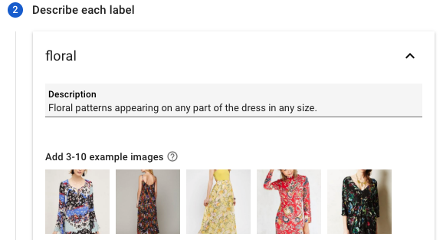
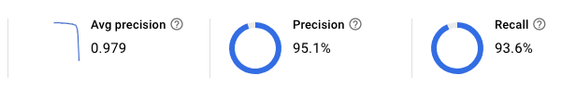
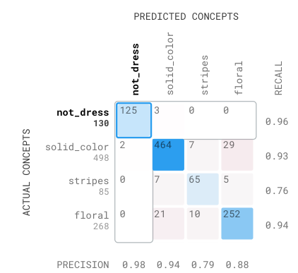
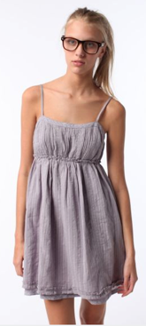
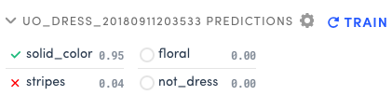
Benefits for Data Scientists and Researchers
Human Labeling
Benchmarking
Rapid Audit & Visualization
Notes:
Human Labeling
Google AutoML offers an equivalent of a premium labeling service for between $35-$100 per 1000 images completed within 24 hours
Very convenient as it’s inherently tied into the model building process
Rapid Audit & Visualization
Able to quickly navigate false positives, false negatives by class
Can re-assign manually
Some can re-train after re-assigning (clarifai, azure)
Benchmarking
Quick sanity check on performance before doing heavy internal research
Everything runs within a half hour, often less than 5 minutes

Slide 8
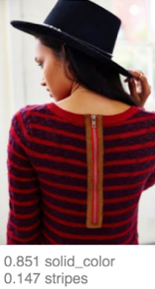
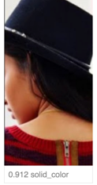
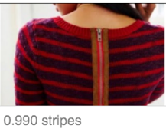
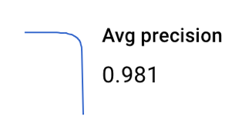
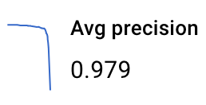
What’s Missing Today for Target Audience
Preprocessing Assistance & Explainability
Identify Utility of Additional Training Time
0.912 solid_color
1 Hour Train
24 Hour Train
0.851 solid_color
0.147 stripes
0.990 stripes
Notes:
Talking Points
For those of you working this effort, here are some gaps we identified for new users
Some services (Clarifai) help with determining how to improve the model. But it’s a document, not interactive based on the datasets.
Data Quality Assistance
Images may need cropping or localization before using
e.g. classifying a hat caused solid, show image
Inform Utility of Additional Training
How does a developer know if it is worth spending more money for more training hours?

Slide 9
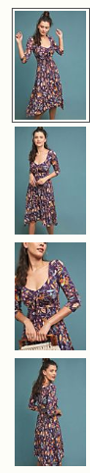
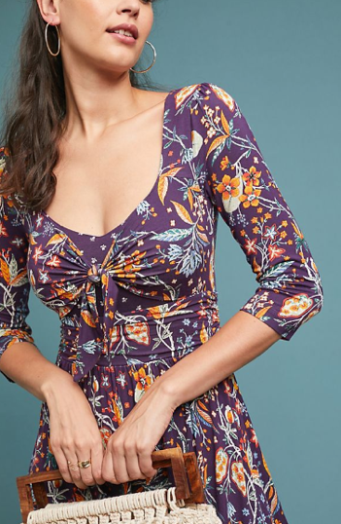
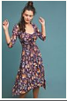
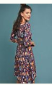
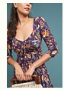
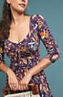
What’s Missing Today for Target Audience
Identify What Type of Additional Data Improves Performance
& Feedback Driven Interaction
“Beloved Dress” Product Images
Predictions
Length | Score
Mini | 0.04
Midi | 0.83
Maxi | 0.13
Dress Length Classifier
(?)
Train
Model
Predict
Notes:
Talking Points
Identify What Type of Additional Data Improves Performance
e.g. will more samples actually improve performance?
Feedback driven interface (reference Clarifai is close)
Showing performance is nice, but huge value if it can show how the performance can be improved,
e.g. more images, diversify images, pre-process, etc.
Other Unsorted:
Free train/cross-val preview, but pay for predictions (Salesforce)

Slide 10
Custom Vision Model Conclusions
Operationally adequate performance | Performs reasonably well on smaller samples for benchmark datasets
Utility for Data Scientists | Human labeling, rapid benchmark, and convenient visualizations at affordable prices
Work needed to reach full democratization | Data preparation & cleansing still manual. Can’t just outright trust the results from performance metrics. Needs inspection.
URBN engineering blog post and source code to follow!

Slide 11
BACKUP
Notes:
Talking Points:
URBN
Wide age range of customers: Many Anthro customers who started when we opened still here
Different brands have different customers
URBN and Anthro are more “life stage” brands, FP niche
Competitors: fast fashion to department stores
URBN Data Science
Two roles: consultation and ML practitioners
Industry Trends
More purchase coming from ecomm but return rate is higher there
Oppurtunity for omni-channel: pick pack and ship, buy online pick-up in store
Opportunities:
Automate manual processes: e.g. reporting
Enable data-driven decisions: e.g. Celect in-store assortment planning, CLV
Improve products and customer experience: e.g. Personalization, visual search, recommendations, etc.
People:
Data science group: started 1 year ago. Still in exploratory phase to identify longer-term opportunities
Data engineering group: robust engineering organization with data engineering to deploy AI. Don’t need to rely on consultants or 3-rd party integrators

Slide 12
Related Work
A Performance Benchmark of Google AutoML Vision using Fashion-MNIST
Detailed overview of Google AutoML, evaluating Fashion MNIST using 24 compute hours
Includes source code
Comparing Machine Learning (ML) Services from Various Cloud ML Service Providers
Covers non-custom (pre-trained) services for NLP, Vision, and Text-to-Speech

Slide 13
Performance Comparison Average AUC ¹
AUC | MNIST |  | Fashion MNIST |  | CIFAR-10 |  | UO Dresses
 | Min² | Full | Min² | Full | Min² | Full | Min² | Full
Google AutoML (1hr) | 0.992 | 0.995 | 0.972 | 0.961 | 0.965 | 0.986 | 0.980 | 0.989
Clarifai | 0.984 | 0.998 | 0.974 | 0.991 | 0.982 | 0.993 | 0.965 | 0.978
Salesforce Einstein | 0.950 | - | 0.981 | - | 0.967 | - | 0.975 | 0.979
Microsoft Azure | 0.988 | 0.998 | 0.973 | 0.985 | 0.980 | 0.993 | 0.957 | 0.967
Basic CNN |  |  |  |  |  |  | 0.816 | 0.905
Transfer Learning³ |  |  |  |  |  |  | 0.967 | 0.976
Public Benchmark | - | - | - | - | - | - | - | -
1. Rounded to 3rd decimal
2. Min: Minimum requested by services (100 images/class)
3. Transfer Learning: Resnet-50 architecture pre-trained + variants

Slide 14
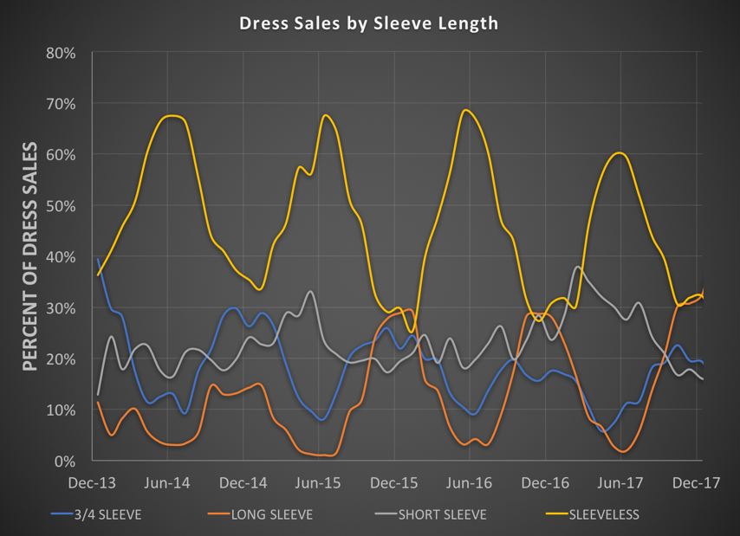

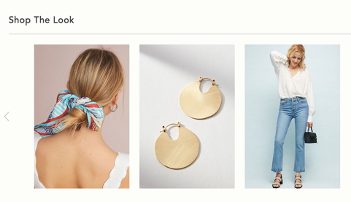
Automated Fashion Product Attribution
Attributes: Dress length, neckline, sleeve length, pattern, material, color, etc.
Applications: Trend analysis, purchasing, planning, inventory management, customer analytics, faceted navigation, “style-with”
Challenges: Time consuming, error-prone, evolving
10M+ photos, creative-focused
Various backgrounds, models
Approach: Apply ML to automatically infer product attributes
Options: In-house model, vendor-supplied solution, vendor-aided solution

